Slide 1
Capstone Project
Battle of the Neighborhoods - Boston

Slide 2
Which neighborhood to move to in Boston if you are new?
When moving to a new big city such as Boston, there are numerous neighborhoods to choose from
Factors such as the population density, home values, and the diversity of services in a selected neighborhood could be important
It would be helpful if neighborhoods with similar characteristics are grouped together for consideration

Slide 3
Data acquisition and preparation
List of Boston’s zip codes obtained from Boston.gov
Duplicate zip codes were removed
Population data and median home value obtained from uszipcode package
Some zip codes did not contain data and were removed
Some zip codes had similar names
Venues data obtained from Foursquare via API calls

Slide 4
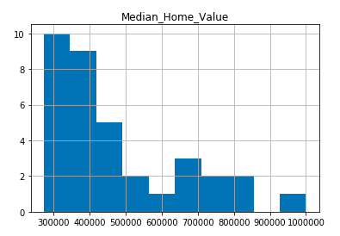
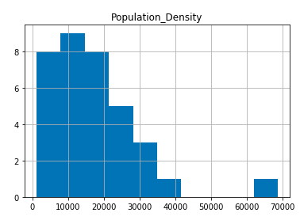
Median home values and population density are clustered on the lower end of the range

Slide 5
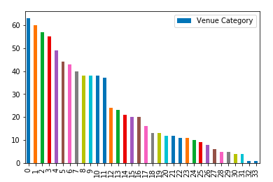
There is a wide spread in the unique venue categories of each neighborhood

Slide 6
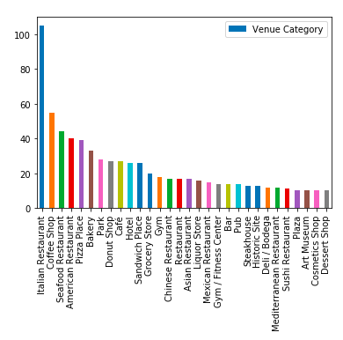
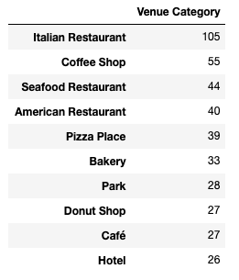
The most popular venue category by a wide margin is ‘Italian Restaurant’

Slide 7
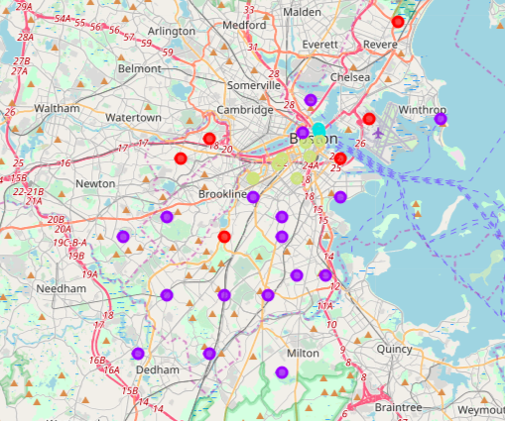
K-means clustering applied with k=4; clusters produced appear to be intuitive
Clusters make sense intuitively by location
Neighborhoods in the center are clustered together while those on outside are clustered together

Slide 8
Cluster analysis
Cluster 0 (Red) – Affordable with moderate diversity and availability of popular venues types
Cluster 1 (Purple) - Generally poor diversity and non-availability of popular venues
Cluster 2 (Cyan) – High end with high diversity and available popular venues
Cluster 3 (Yellow) – High end with high diversity and available popular venues
* Cluster 2 contains only 2 neighborhoods and appear to be very similar. Geographically they are very near to each other, hence unsurprising.

Slide 9
Conclusion
Simple tool used to determine which neighborhoods within Boston were most attractive with just a few parameters
Intuitive clusters emerged with the use of k-means clustering
Limitations: lack of a clear pattern within each cluster for population density and median home value – contribution might have been diluted with popular venue categories.

